Slide 1
A Whole Team Approach To Testing
Jon Kruger

Slide 2
Dude, this isn’t a QA conference

Slide 3
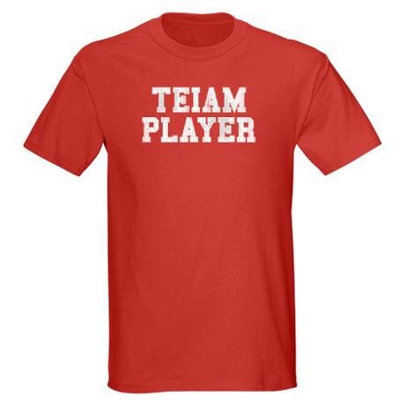
Notes:
We need to treat software teams like an actual team! Not siloes of people who act independently of each other without caring about other silos within the group

Slide 4

Throwing it over the wall
Notes:
On most software projects, developers write code and throw it over the wall to QA. Good luck QA team!

Slide 5
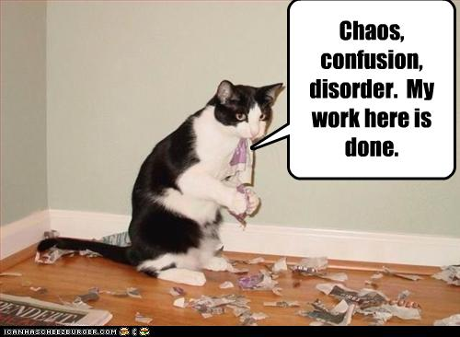
Confusion
Notes:
QA is confused – they get a feature to test, but this is the first time that they have ever seen the details about the feature. How do we expect them to do a good job of testing it if they have no idea what it’s supposed to do? Not only that, but in some cases the developer finished working on the feature weeks ago and has moved onto something else long ago.

Slide 6
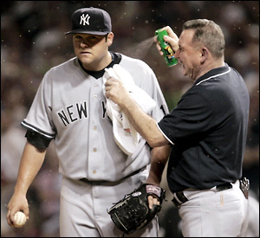
Bugs
Notes:
This approach usually ends with lots of bugs.

Slide 7
What are we building?
Notes:
- When this happens, we don’t really know what we’re building. BAs write requirements with one thing in mind, developers interpret another way, and QAs then interpret it another way.
- This just makes you mad at QA for writing up bugs that aren’t bugs

Slide 8
A new way forward
Notes:
- What if we tried to communicate better with QA so that we could have less confusion?
- What if we tried to get QA to help us not write bugs in the first place?

Slide 9

QA is not…
Notes:
QA is not an external auditor that is going to come sometime when you’re not expecting it to make sure that you’re following all of the rules.
QA teams should provide “independent verification”, but that doesn’t mean that you can’t work together with them to make sure that your code is correct.

Slide 10
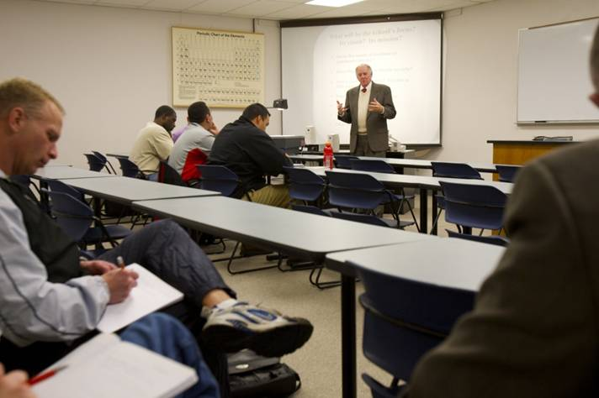
QA is not…
Notes:
QA is not like taking an exam in a college class, where you take your best shot at interpreting requirements and then have the QA person “grade” how well you did.
We want to do whatever we can to get it 100% right. Imagine taking a test in your college class, having it be an open book test, and having the professor sitting next to you so that you ask him anytime if you’re doing it right.
Or better yet, what if we had the questions for the test ahead of time, we also had the answers for the test, and we had some hints on how to solve some of the complicated questions? (And you have the professor helping you) – remember, all we are doing is translating requirements into code. We aren’t here to interpret it in our own way, we are just translating.

Slide 11
Working Together
How is QA going to test the feature?
How do I know when I’m done?
How can I help QA?
Notes:
If I had a list of QA’s test cases before I write code, I should be able to write my code to make all of their test cases pass, and then I shouldn’t have any bugs.
But wait, some say, won’t you just write your code to make the tests pass? Exactly!!

Slide 12
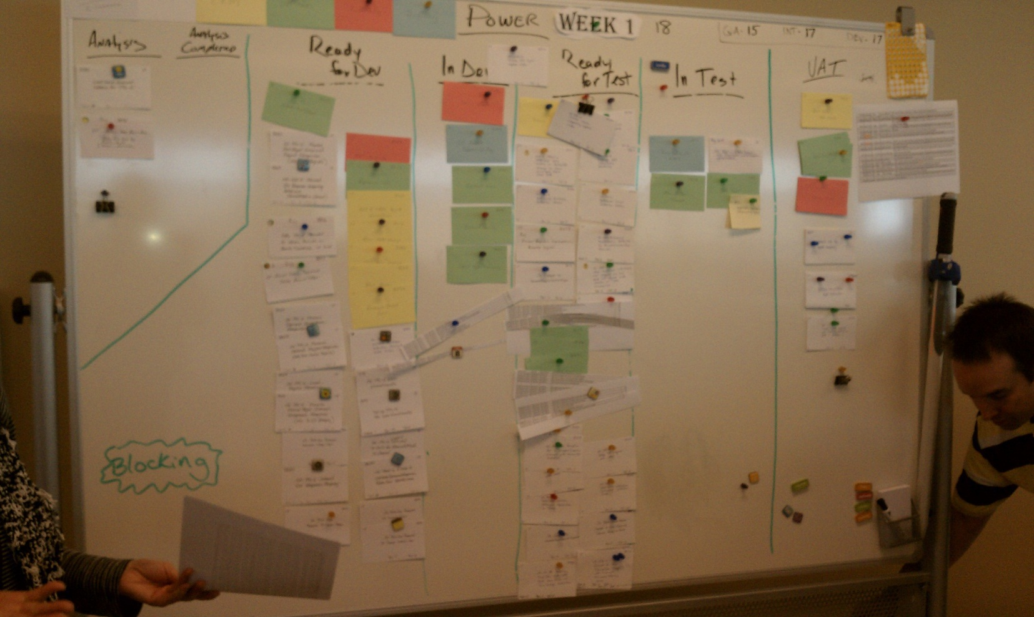
The Old Way

Slide 13
The Old Way
Notes:
Notice the pileup of cards in the “Ready for Test” queue, the cards clipped together, and the printouts of Excel bug lists. Mass chaos!!

Slide 14
The Three Amigos
Notes:
Get a BA, QA, and a developer in a room and discuss a feature before you start developing it. The outcome of this process (not necessarily the meeting itself) should be agreed upon acceptance criteria that indicate all details about what is going to be built and how QA will verify that it is working correctly.

Slide 15
Acceptance Criteria
Given I am a logged in user
When I go to the final checkout page
Then I should see the total cost of the order broken down by product cost, tax, and shipping charges
And I should see the total cost of the order
The “Gherkin” syntax
Notes:
The “Gherkin” syntax is a common grammar and syntax that we can use so that BAs, QAs, developers, and business people can speak the same language and ensure that everyone agrees on what is going to be built.

Slide 16
The Three Amigos
(demo video here)

Slide 17
Feature: Process an order
Given I am a logged in user
When I go to the final checkout page
Then I should see the total cost of the order broken down by product cost, tax, and shipping charges
And I should see the total cost of the order
Order total = total cost of products on the order + tax + shipping charges
Tax:
Ohio = 7%
Michigan = 6.5%
Other states = 0%
Shipping:
If total cost of products (before tax >= $25), shipping is free, otherwise $5

Slide 18
Feature: Process an order
Given I am a logged in user
When I go to the final checkout page
Then I should see the total cost of the order broken down by product cost, tax, and shipping charges
And I should see the total cost of the order
Order total = total cost of products on the order + tax + shipping charges
Tax:
Based on the shipping address, not the billing address
Tax charged on the sum of the cost of the products
Ohio = 7%
Michigan = 6.5%
Other states (including DC) = 0%
No shipping internationally
Shipping:
If total cost of products (before tax) >= $25, shipping is free, otherwise $5

Slide 19
Feature: Process an order – Testing Points
Order with multiple products
Ship to OH, MI, DC
Unit tests to verify tax calculation for all 51 states
Shipping < $25, = $25, > $25
Verify order totals

Slide 20
Feature: Process an order – Test Scenarios
Order with one product, ship to OH, total product cost < $25 (automated acceptance test)
Order with multiple products, ship to MI, total product cost = $25 (automated acceptance test)
Order with multiple products, ship to DC, billing state = OH, total product cost > $25 (automated acceptance test)
Tax calculation for all 51 states (unit tests)
Order cannot be processed for a non-US state (e.g. a Canadian province) (unit test)
Notes:
This is as far as we go in our initial 3 amigos meeting. At this point we’ll break and someone will write out the gherkin for the acceptance tests and then we’ll review the gherkin once it’s written (no need for us all to sit in a room and watch someone type out gherkin).

Slide 21
Feature: Process an order – Acceptance Criteria
Scenario: Order with one product, ship to OH, total product cost < $25
Given I am a logged in user
And the shopping cart is empty
And I add a product costing $24.99 to the cart
And my shipping state is OH
And my billing state is OH
When I go to the final checkout page
Then the tax amount should be $1.75
And the shipping amount should be $5.00
And the order total should be $31.74
Notes:
- This gherkin essentially becomes our requirements, our test plan, our method of verifying that our feature will meet the needs of the business, and potentially an automated acceptance test.
- The gherkin can be written by anyone on the team. The 3 amigos must all agree on the final gherkin.
- Bonus points if you can get people in the business to write requirements for you in this format!

Slide 22
?

Slide 23
Slides, links, code, contact info
Slides, code, links:
http://jonkruger.com/blog/tdd-immersion
Email: jon@jonkruger.com
Twitter: @JonKruger
Blog: http://jonkruger.com/blog

